Slide 1


Career Pathways After FSC (Pre-Medical)

Slide 2
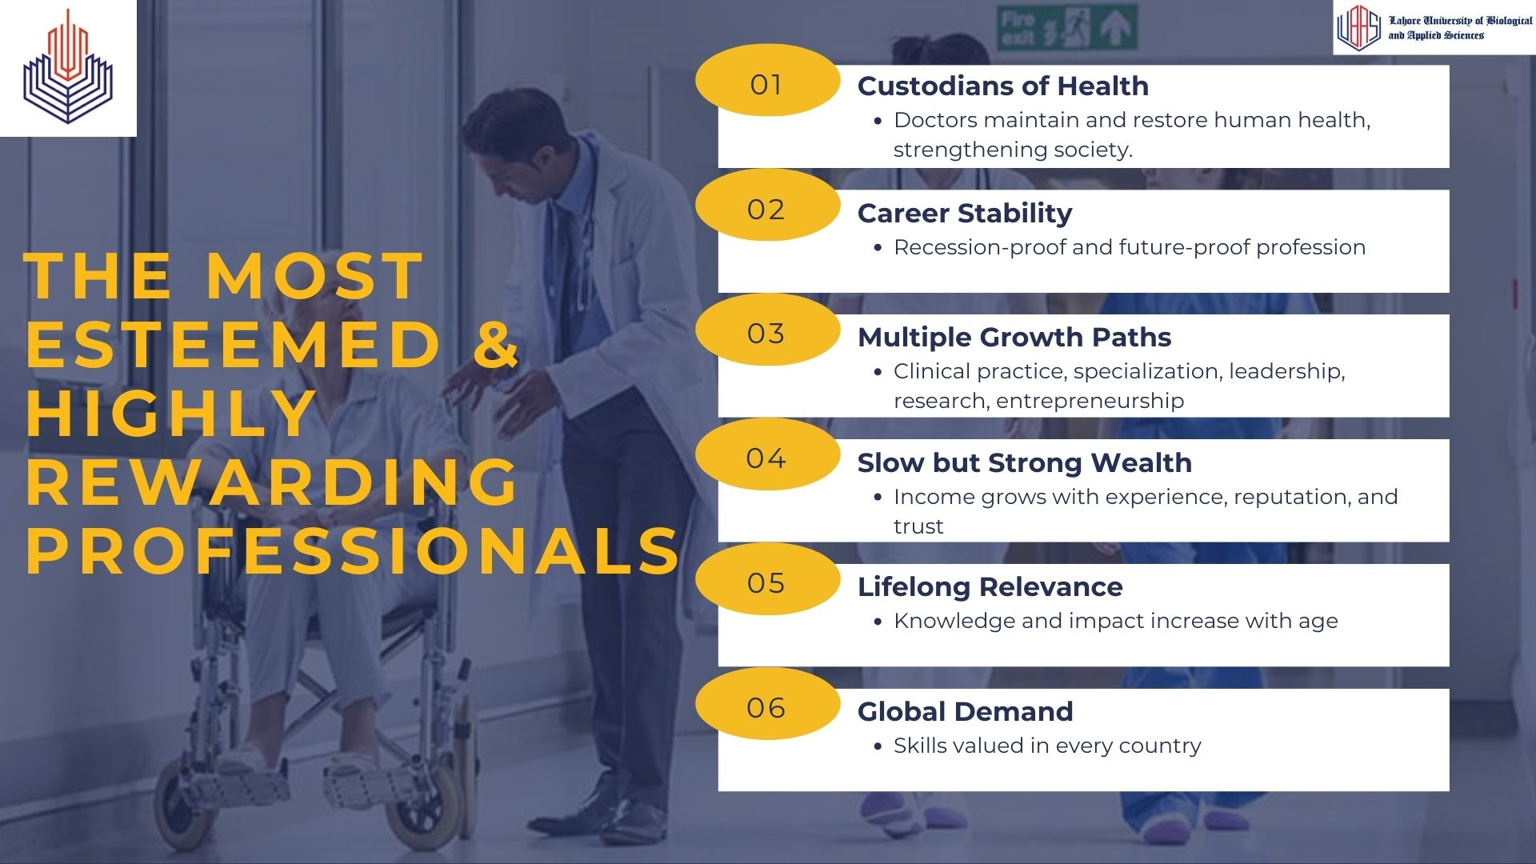

Slide 3
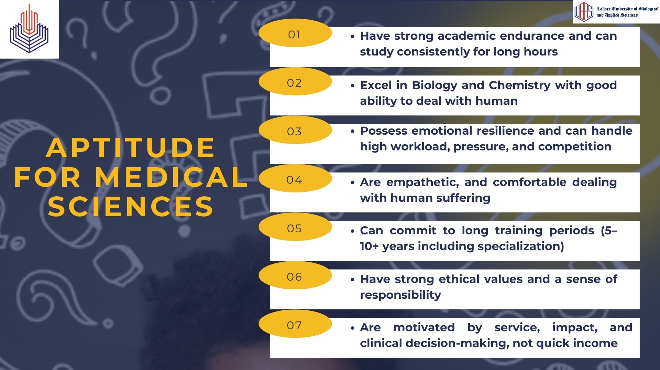

Slide 4
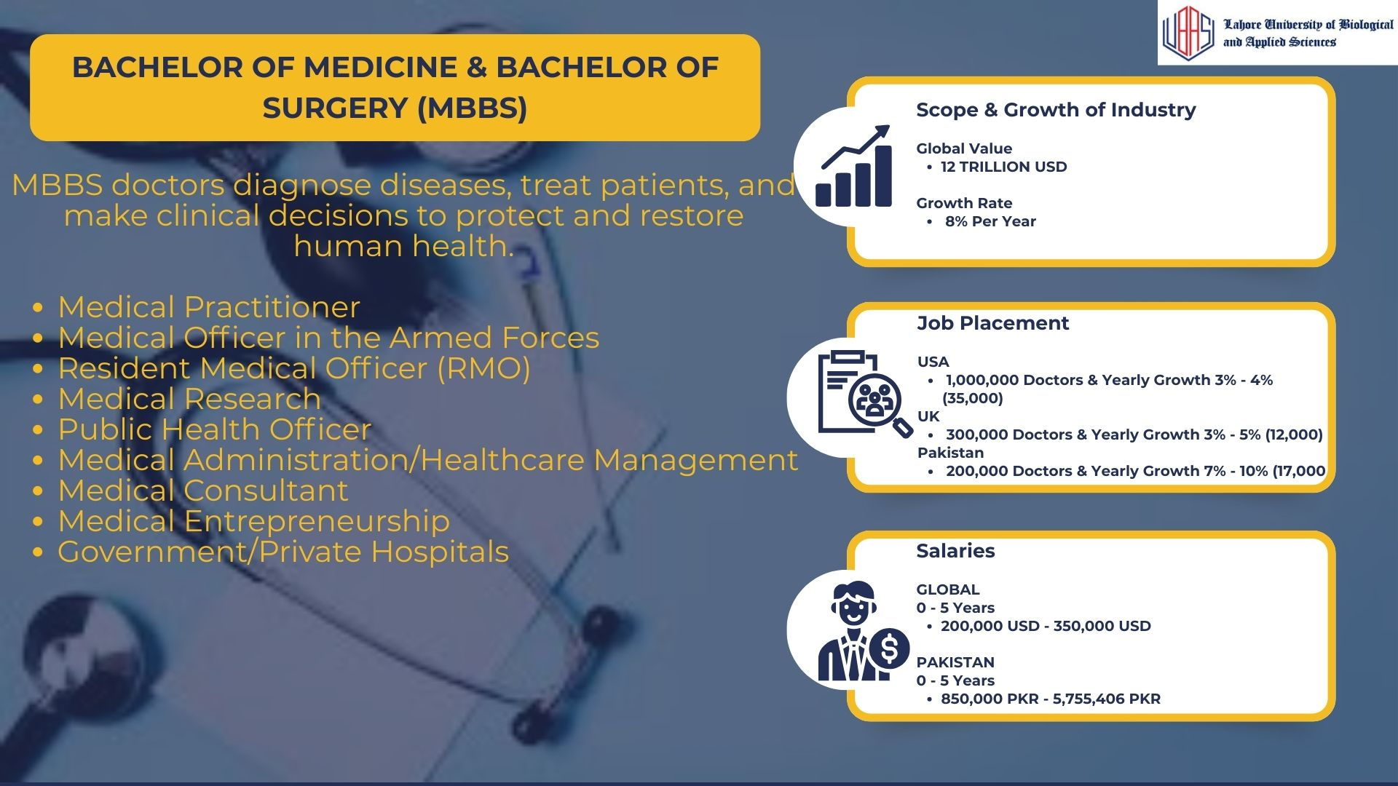

Slide 5
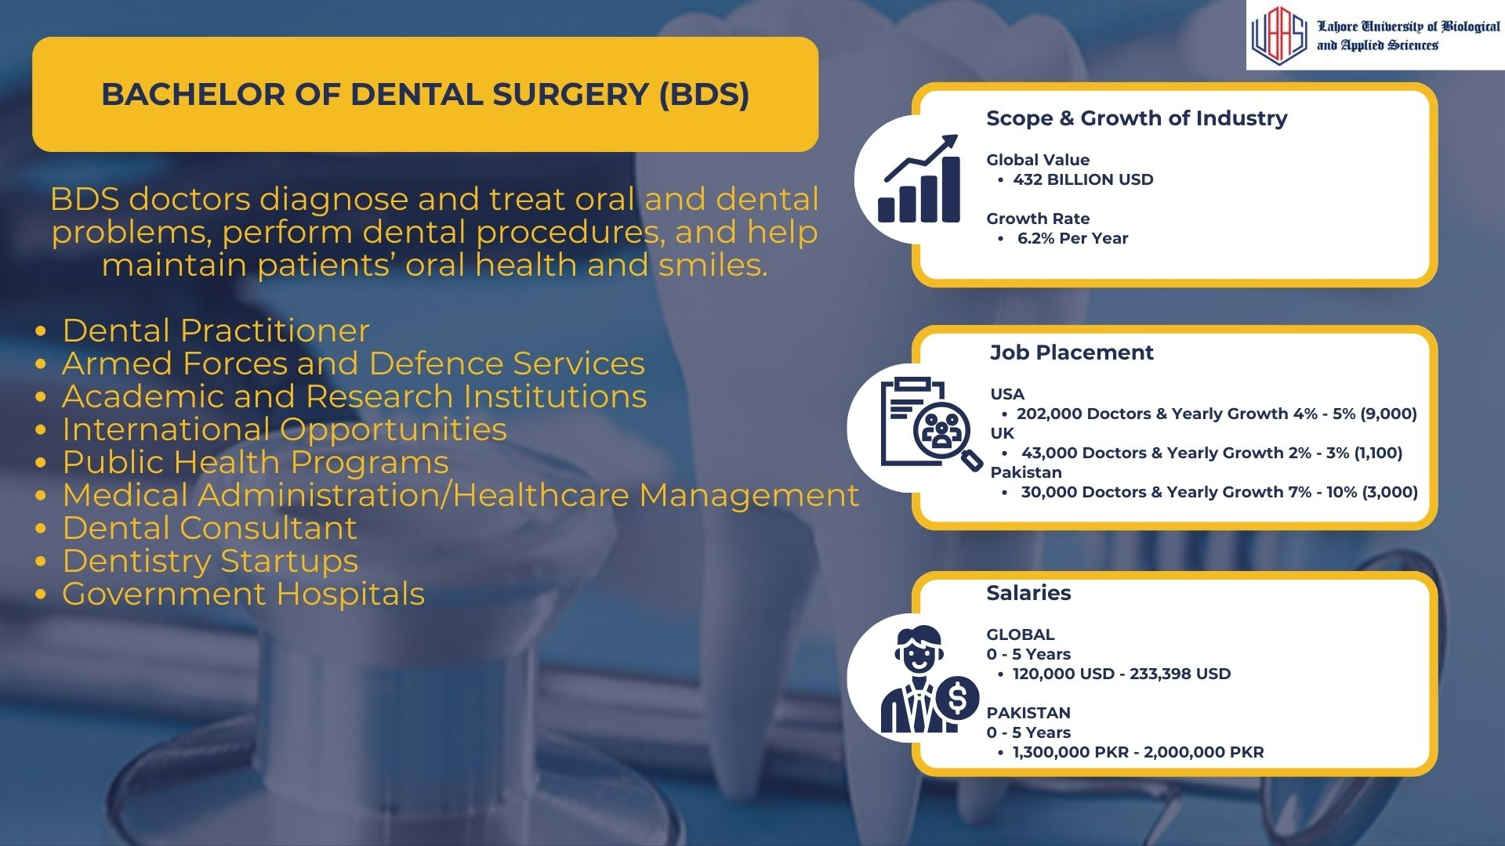

Slide 6
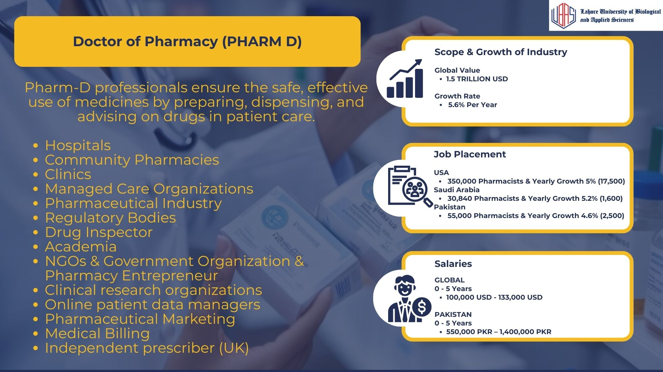

Slide 7


Slide 8


Slide 9
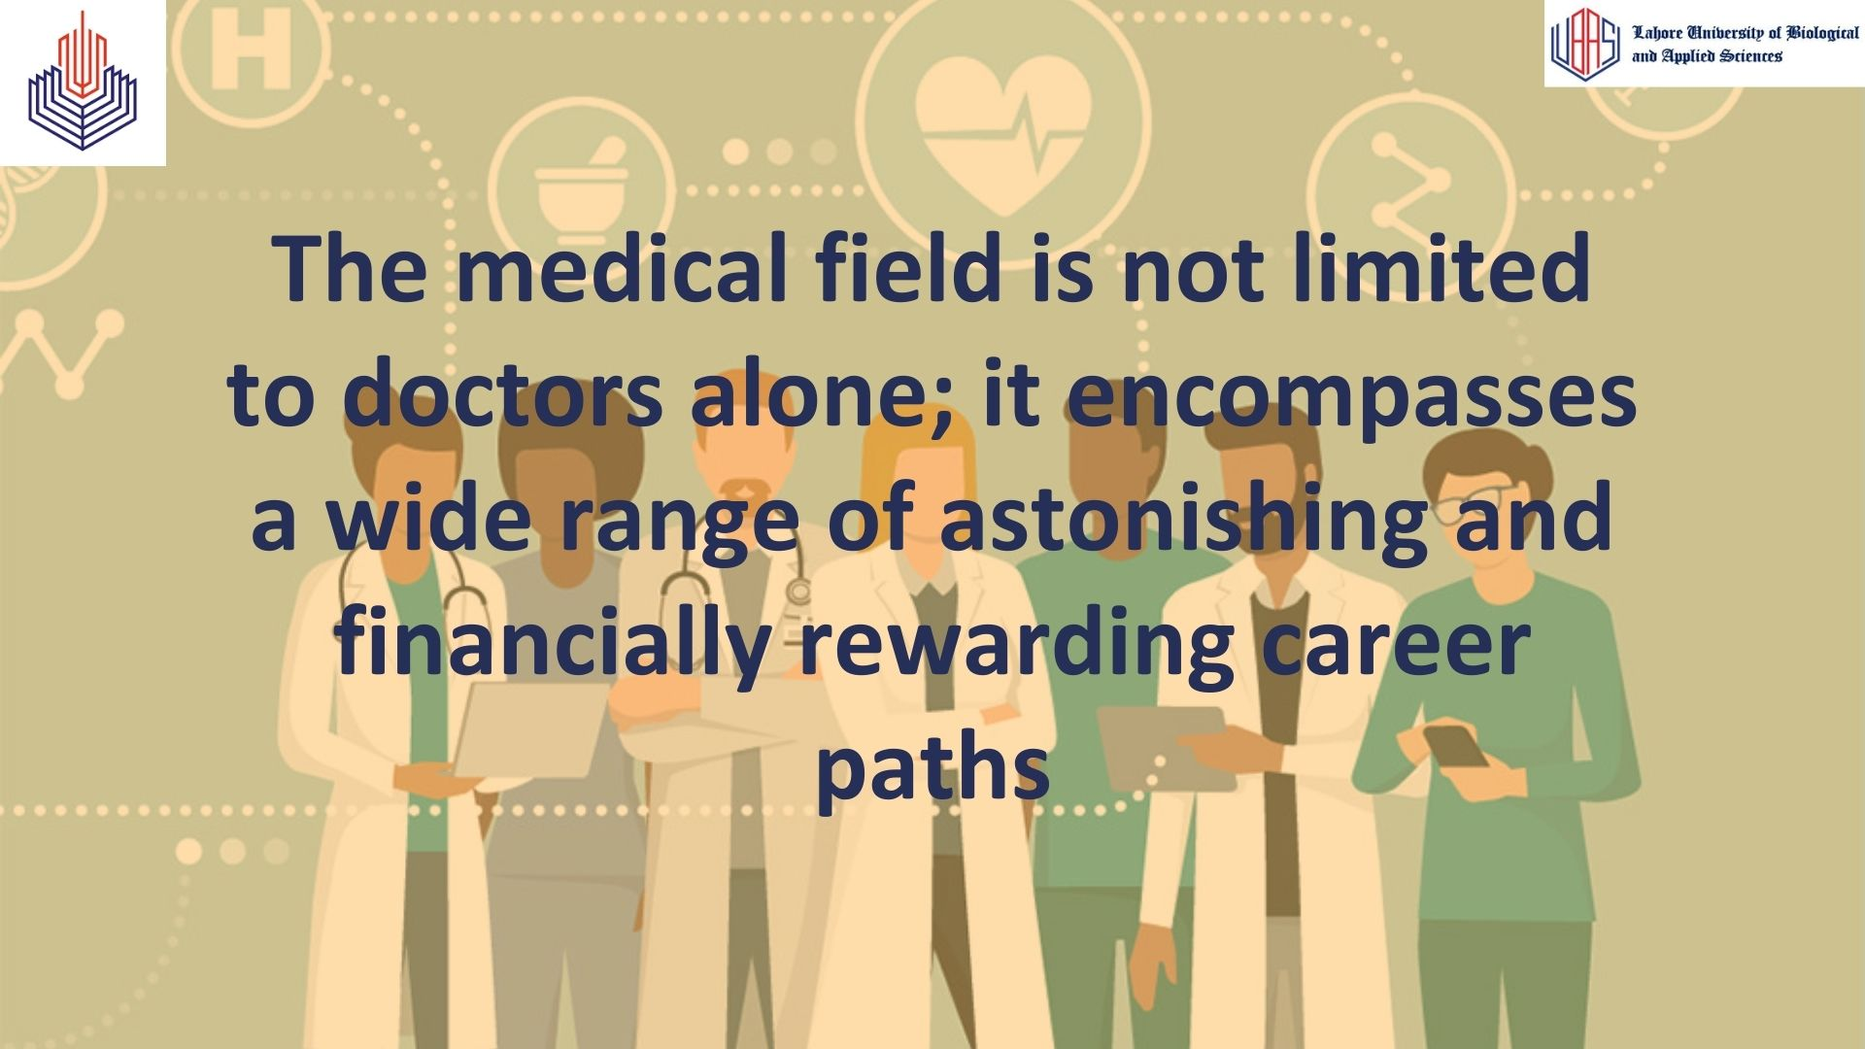

Slide 10
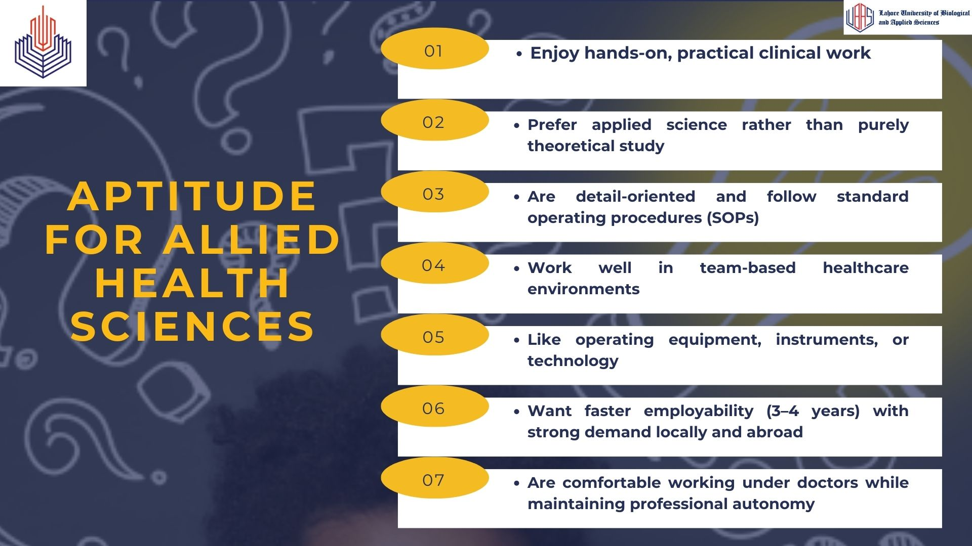

Slide 11
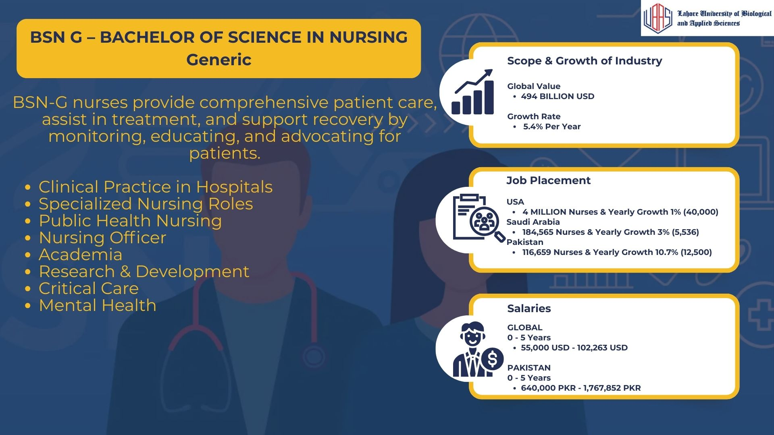

Slide 12
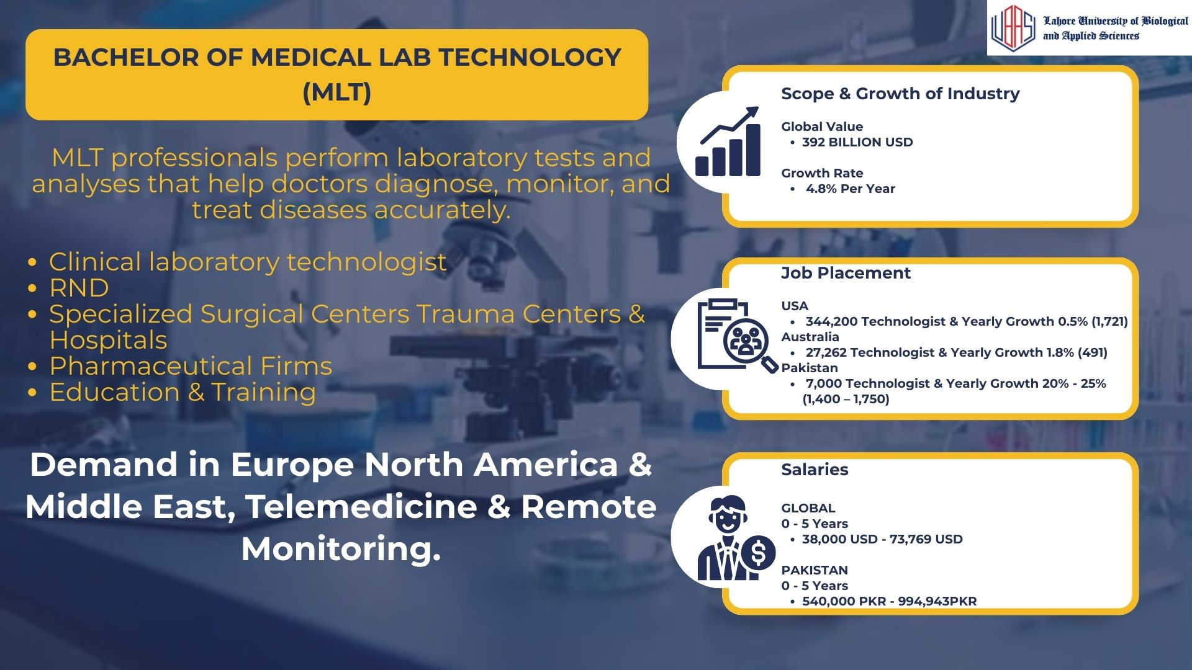

Slide 13
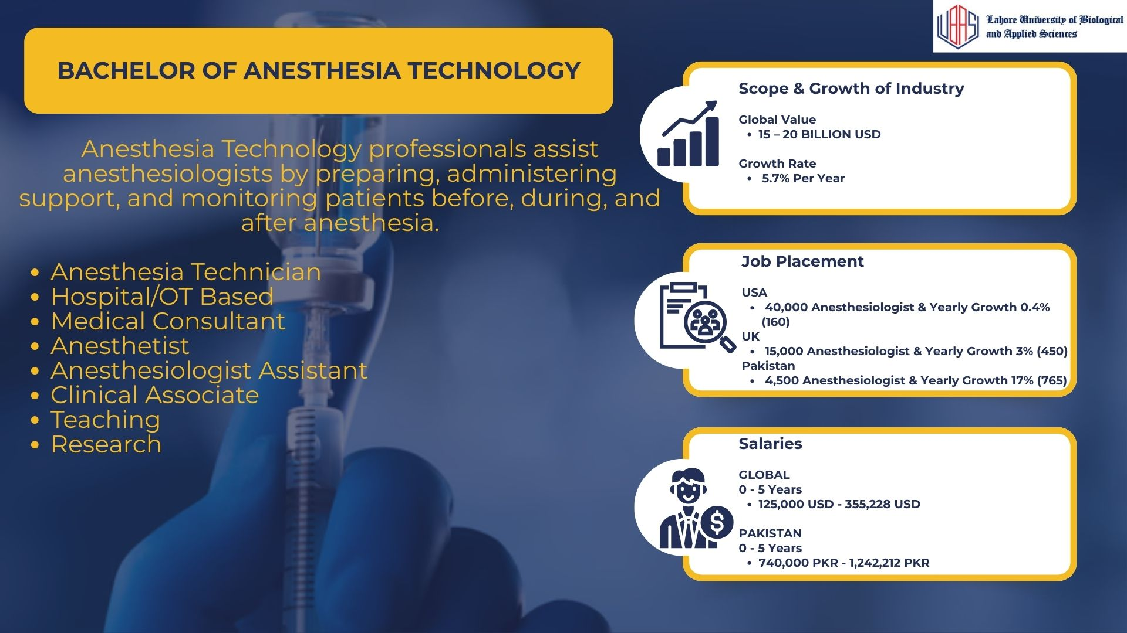

Slide 14
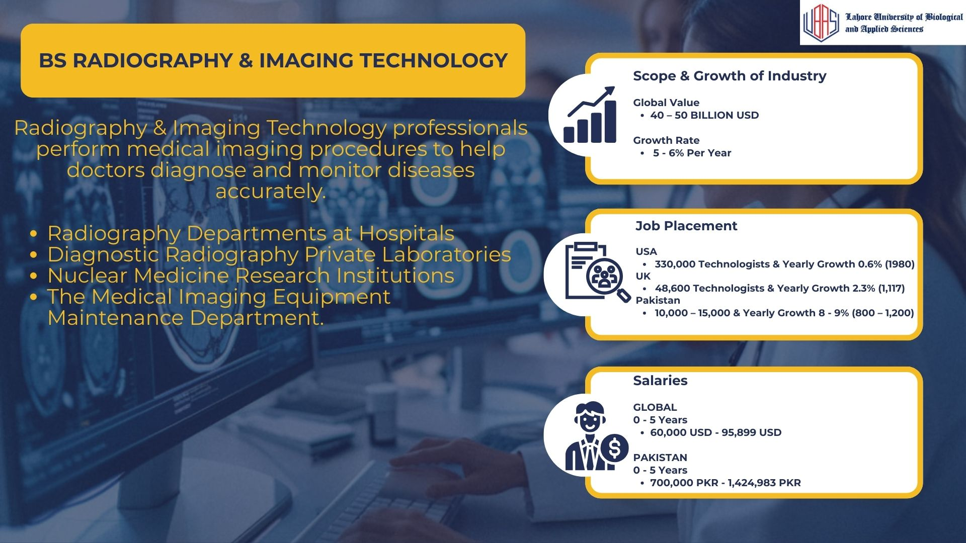

Slide 15
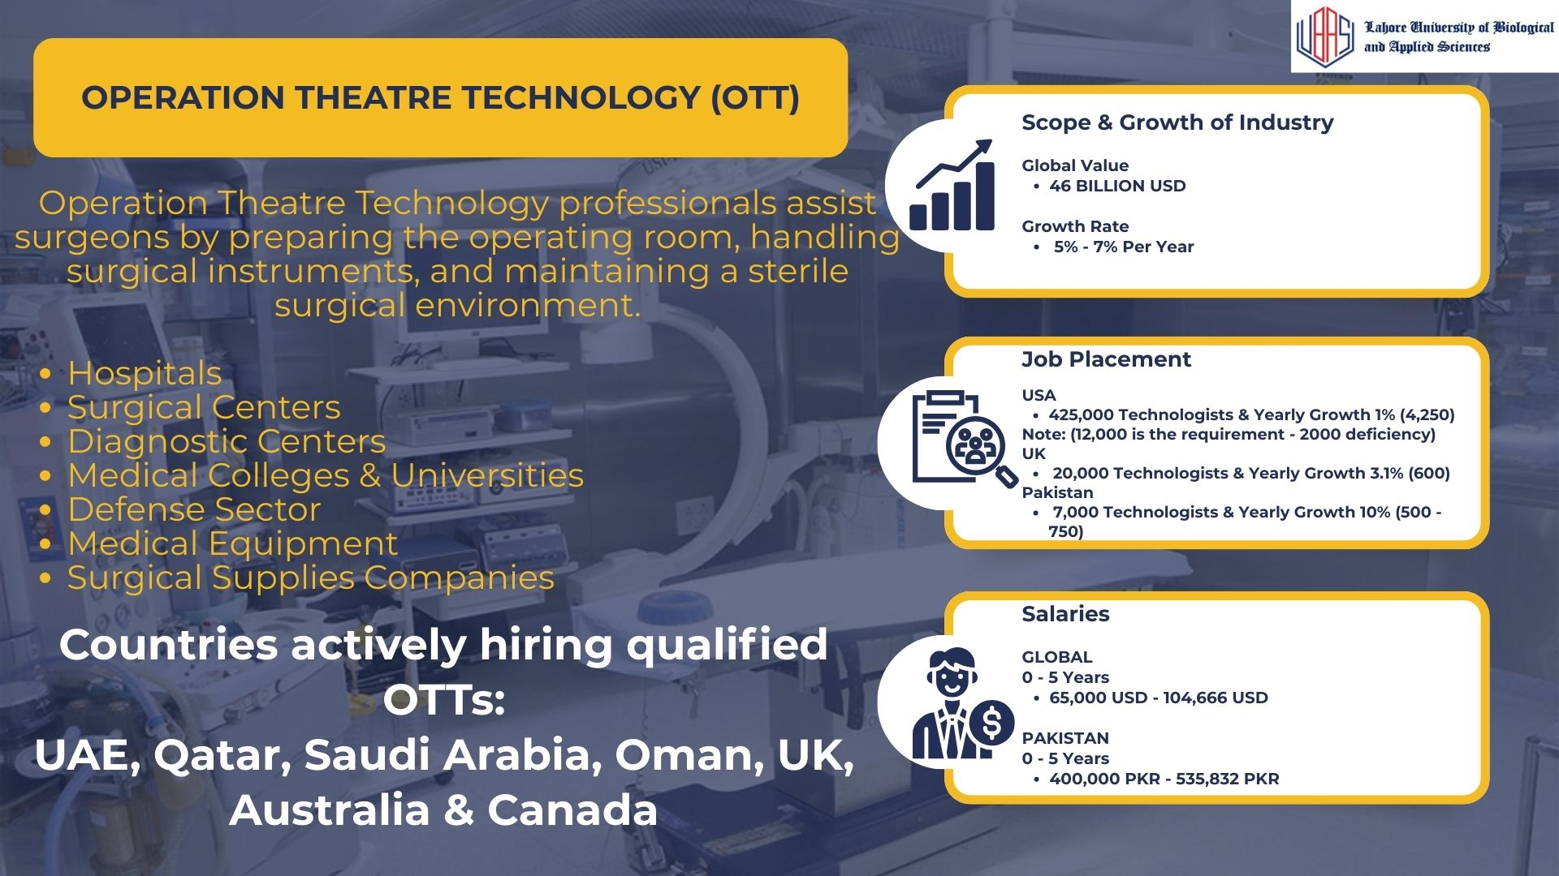

Slide 16
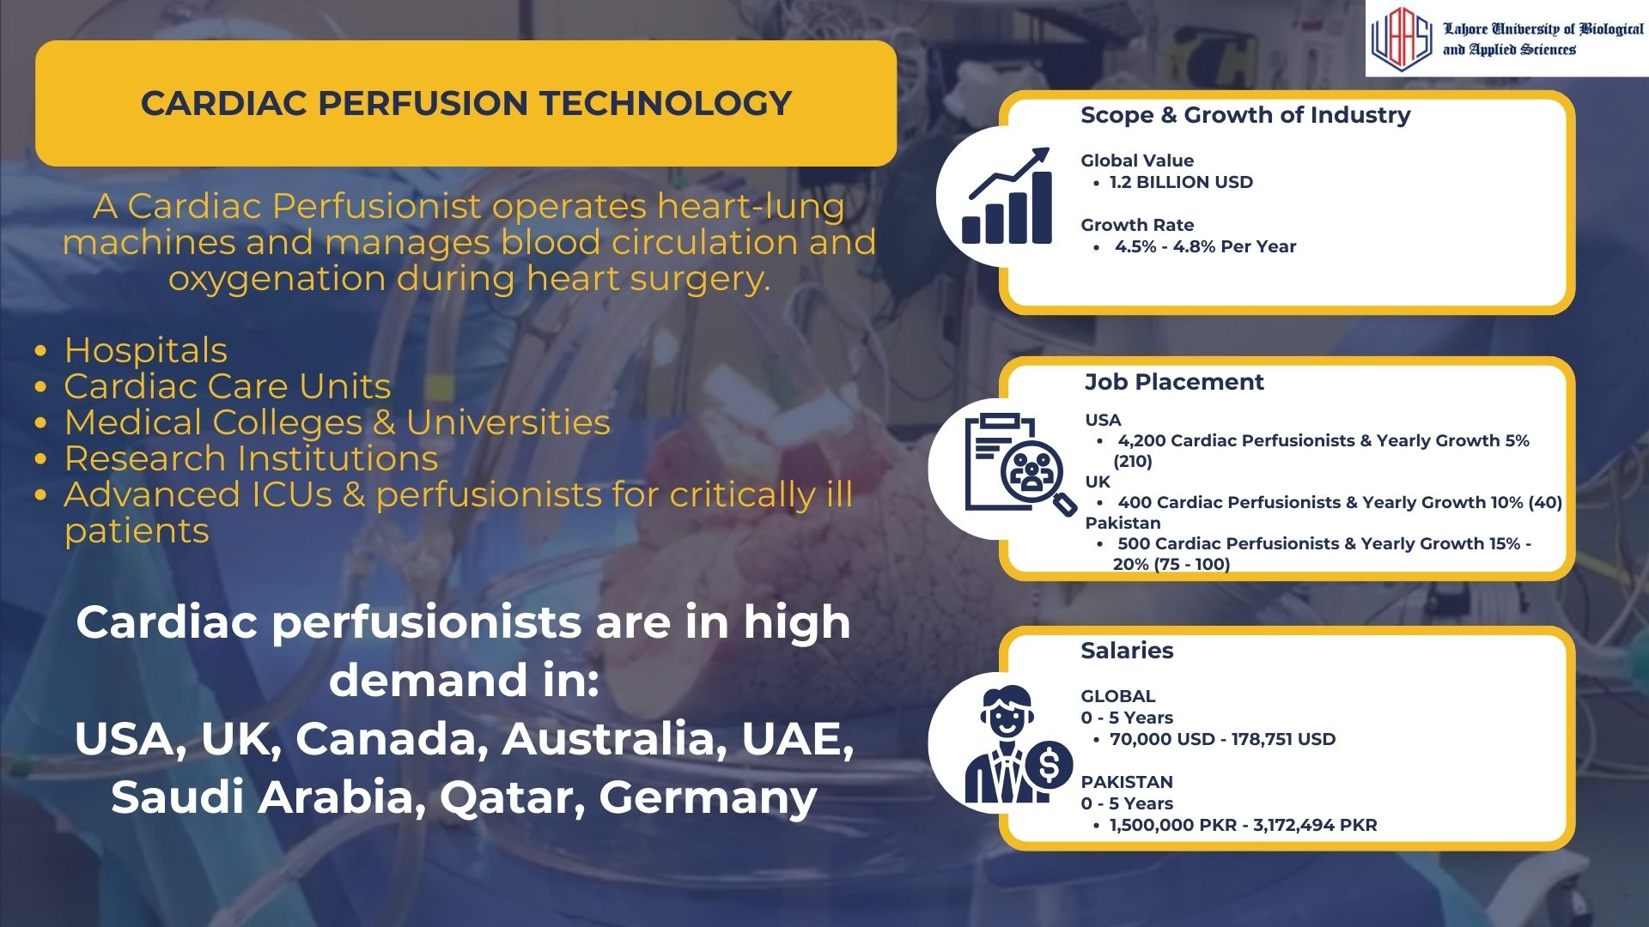

Slide 17


Slide 18


Slide 19
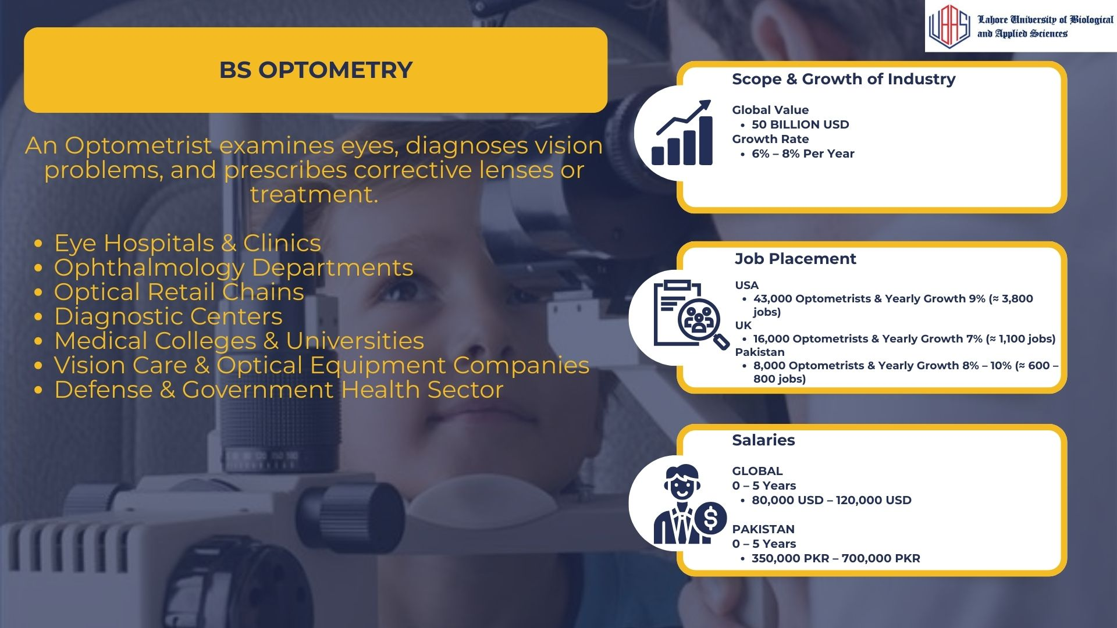

Slide 20
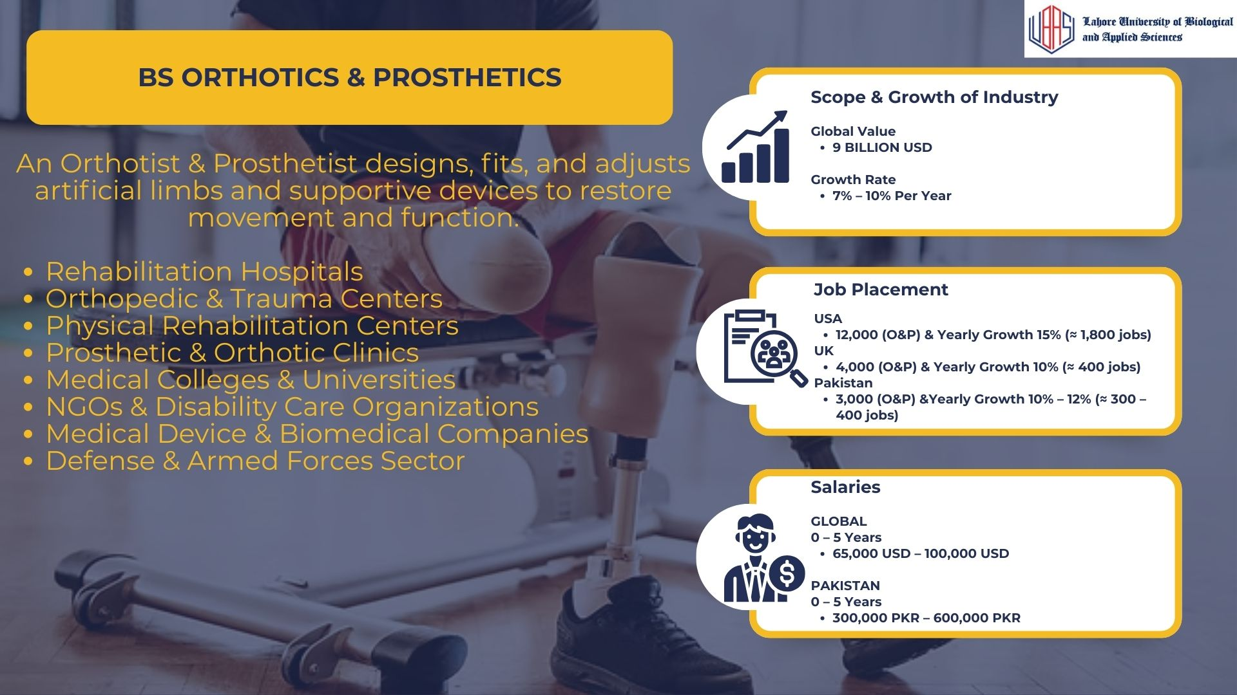

Slide 21
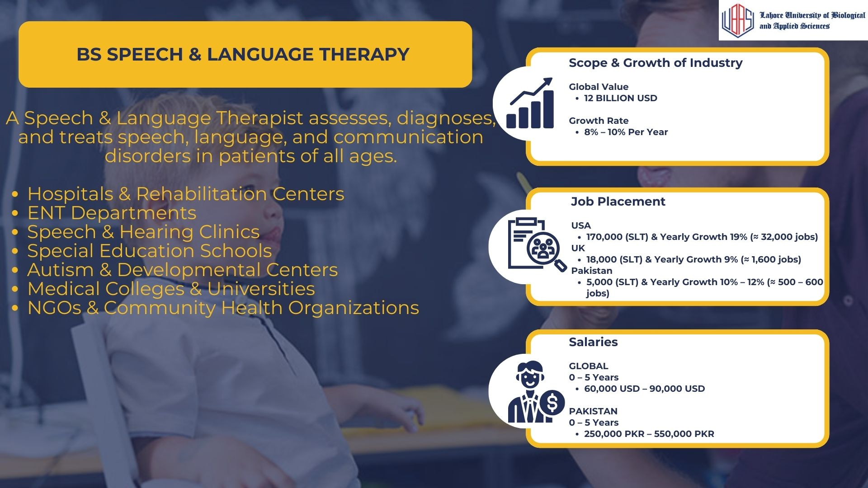

Slide 22


Slide 23
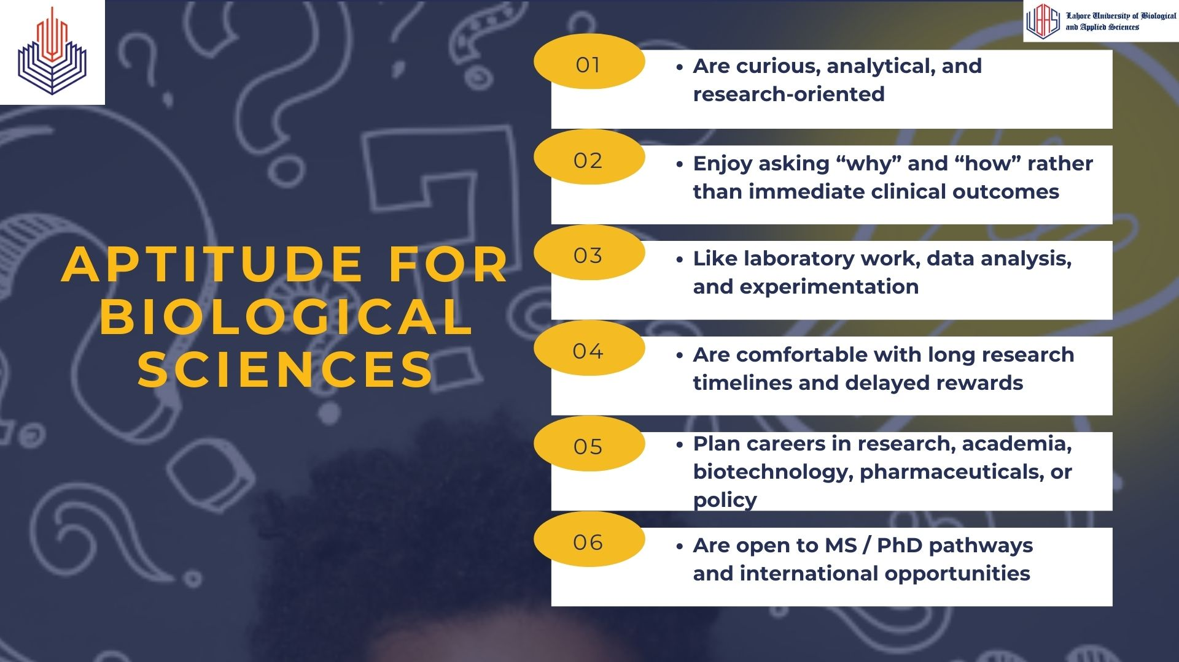

Slide 24


Slide 25
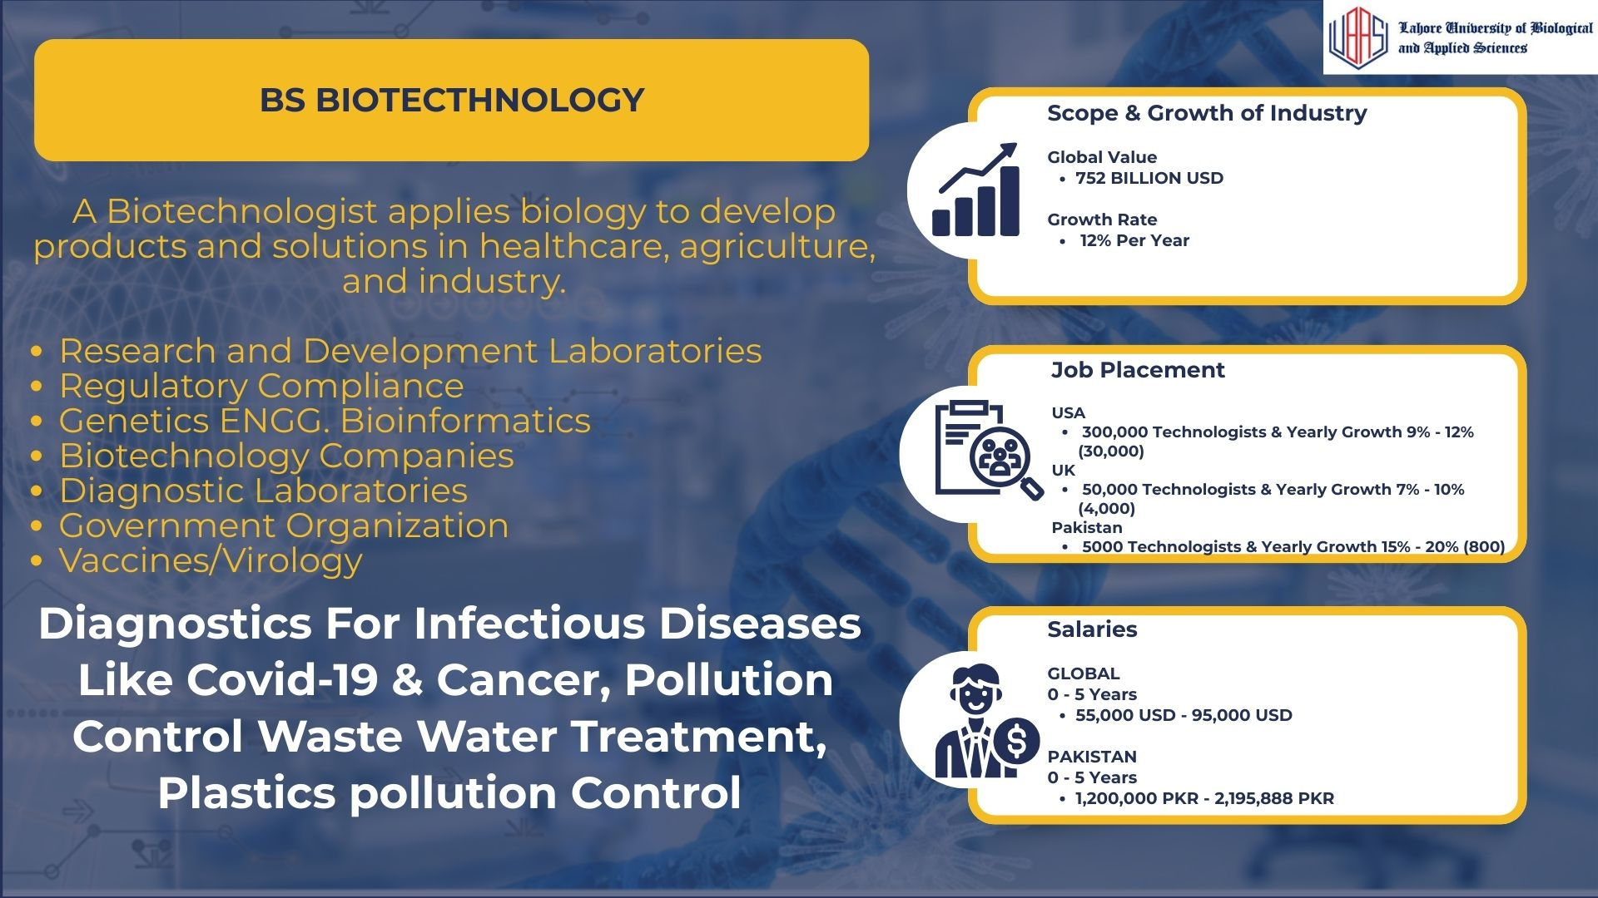

Slide 26


Slide 27
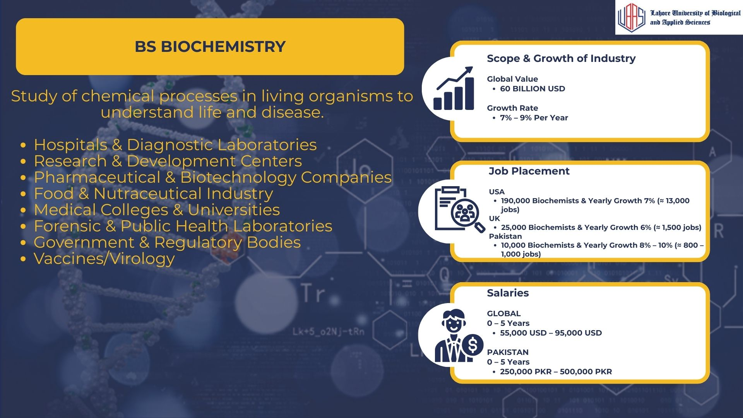

Slide 28
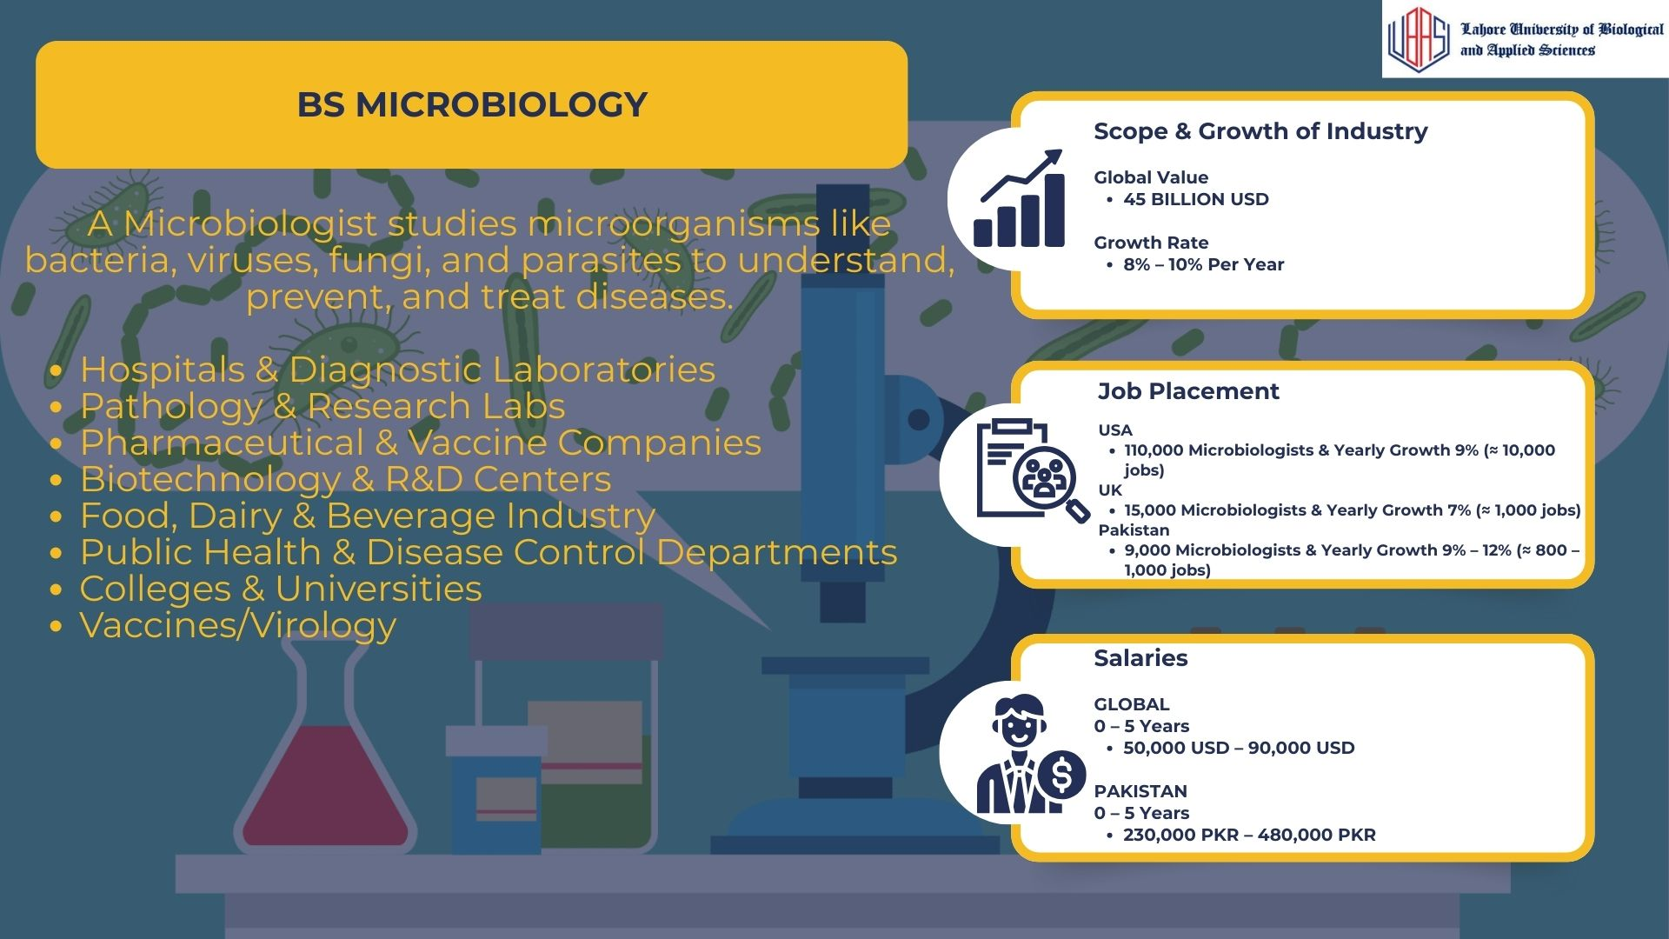

Slide 29
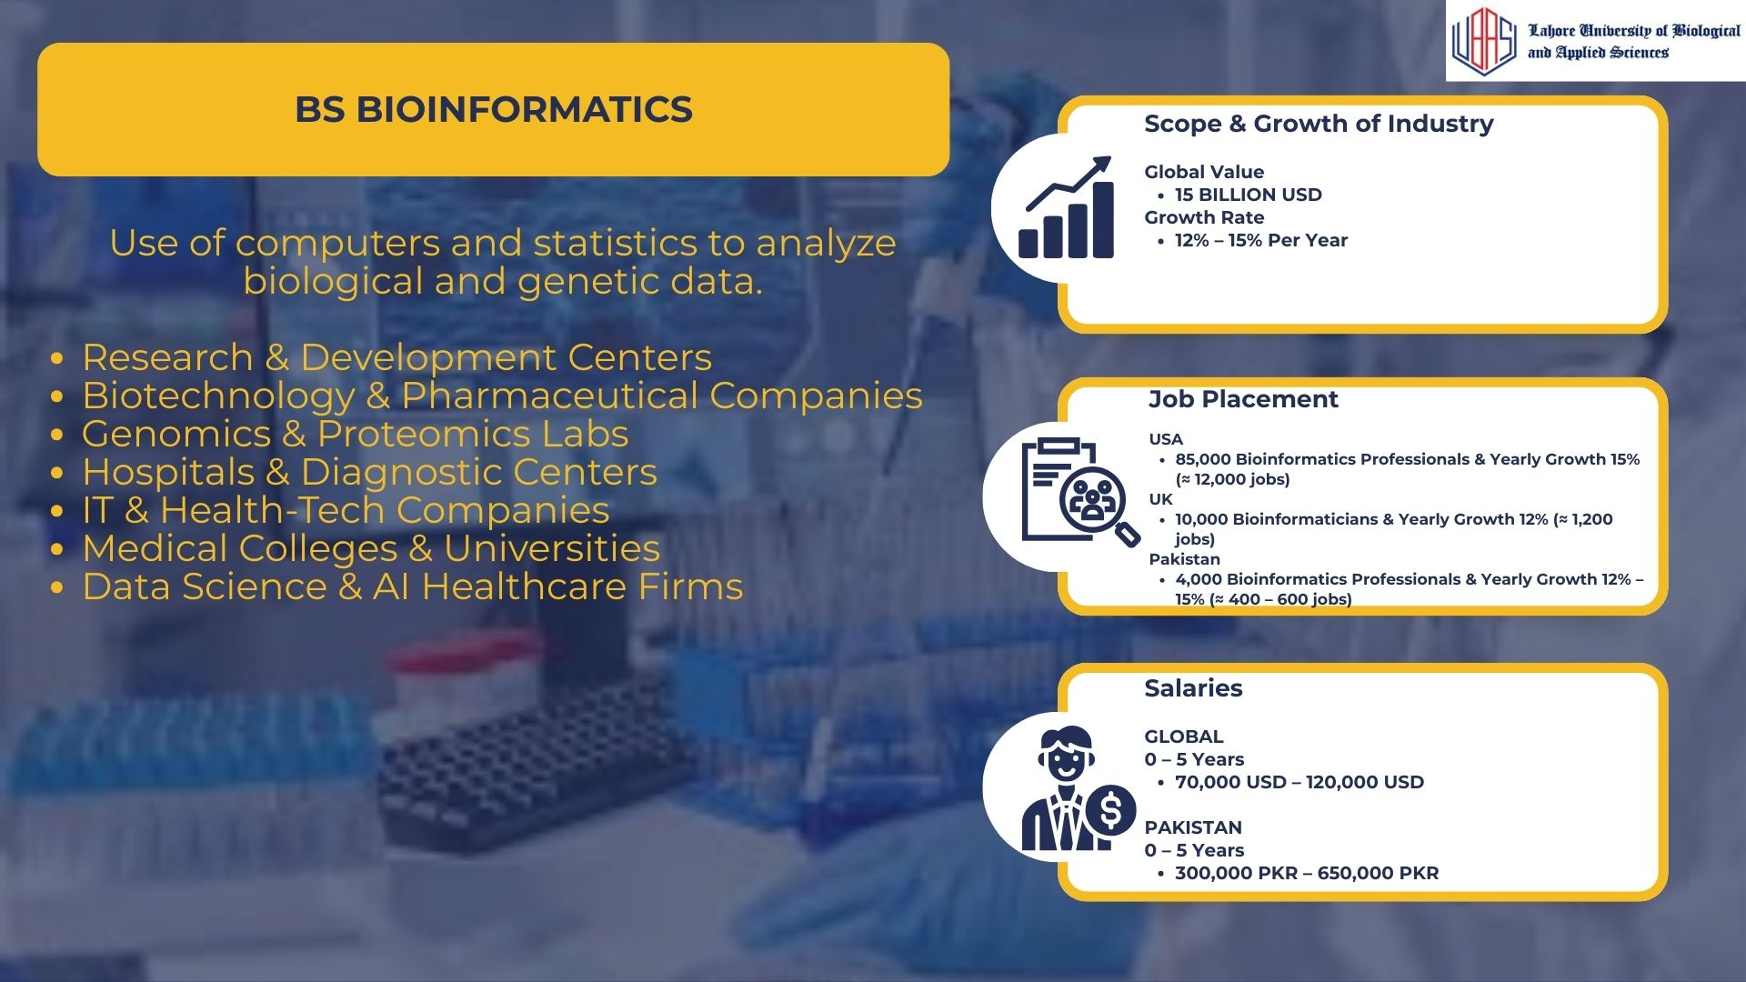

Slide 30
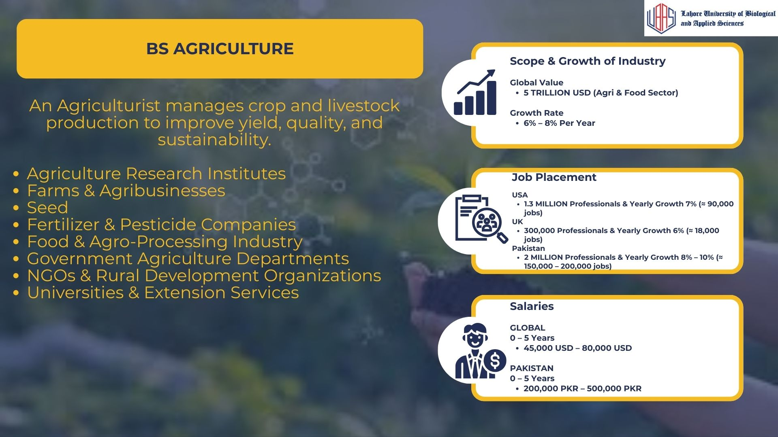

Slide 31


Slide 32

Faculty of Nursing
Notes:
nursing

Slide 33
UBAS
DISTINCTIVE FEATURES
First private Medical & Dental College in Lahore and Punjab
LMDC got awarded with university charter - LAHORE UBAS
Pakistan’s First Simulated Model Pharmacy
Pakistan’s Largest Forensic Museum
International Scholarship Hunt Training (Erasmus,DAAD,CSC,Fulbright,etc.)
Career Counseling Cell
Top LMDC Students Will Be Privileged With Internship at Doctors Hospital,Surgimed & Gurki Hospitals
Privileged to be a part of Larger eco-system of PUNJAB GROUP
Industrial Collaborations
14 Bachelor's Degrees
12:1 student to faculty ratio

Slide 34
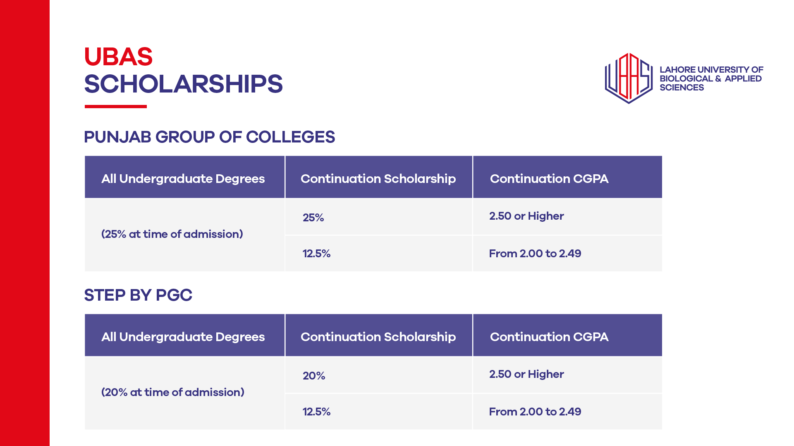

Slide 35


UBAS
X EDUFI
Pakistan’s first Study Now, Pay Later (SNPL) digital platform
NO DOCUMENTATIONS REQUIRED
QUICK PROCESSING TIME
DIRECT DISBURSEMENT TO EDUCATIONAL INSTITUTE
EASY AND CONVENIENT MONTHLY INSTALLMENTS
MULTIPLE PAYMENT METHODS

Slide 36
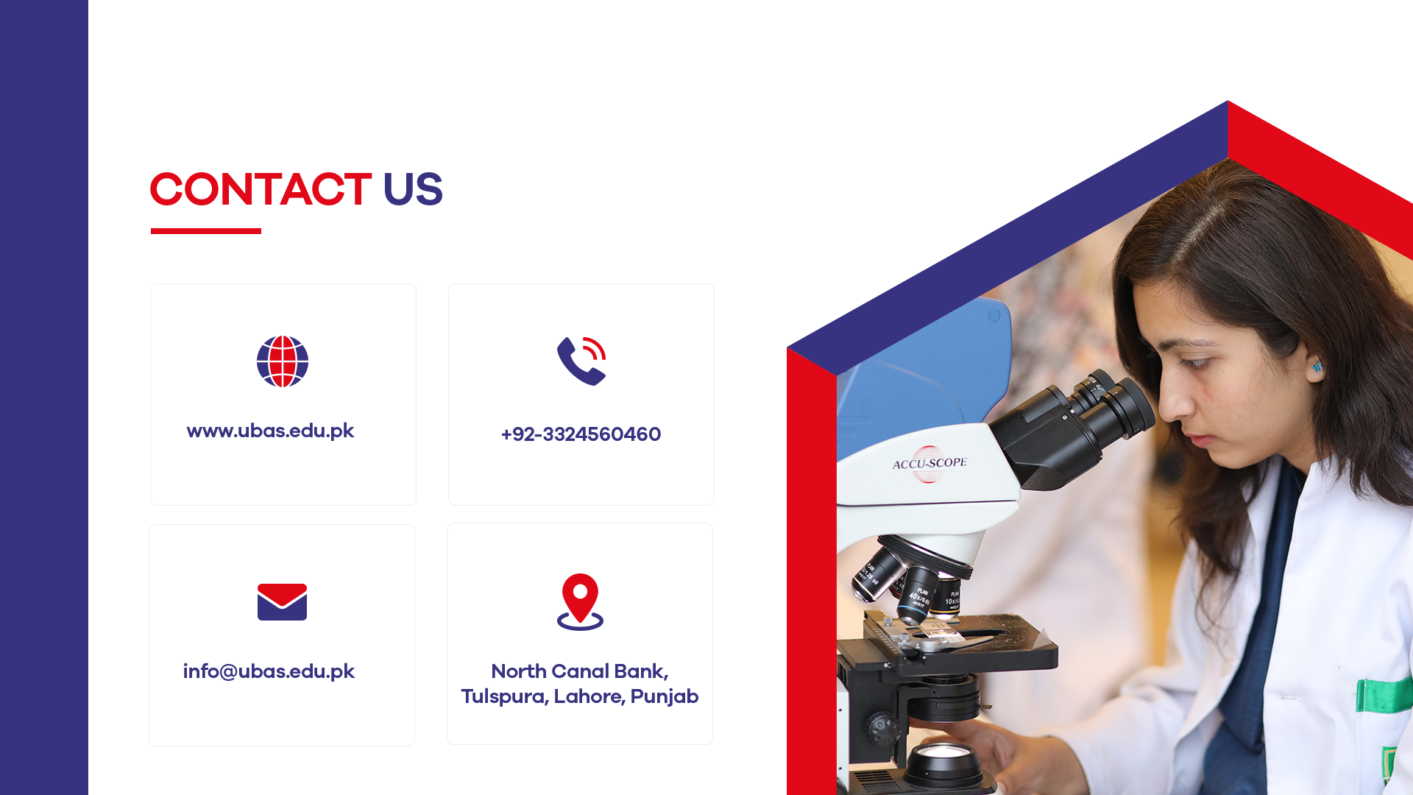
0334-0146506

Slide 37


